Slide 1
Image captioning
with visual attention

Slide 2
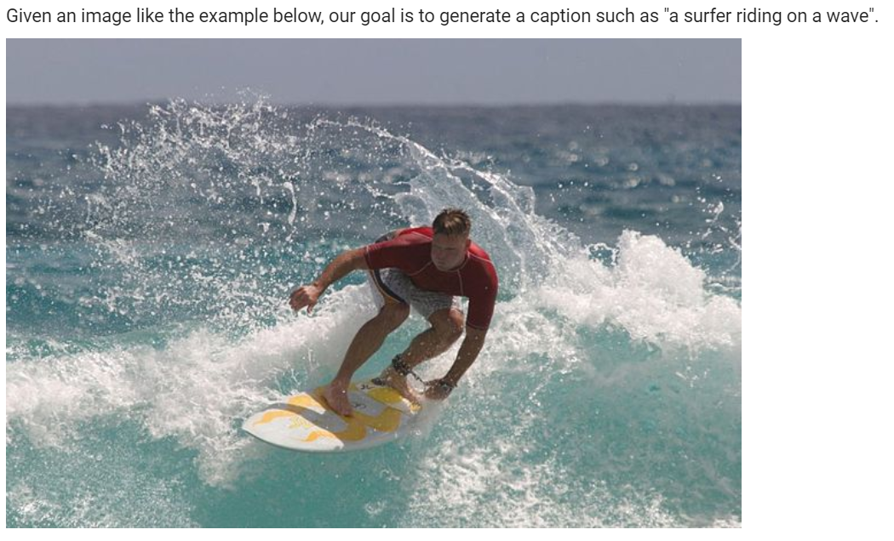
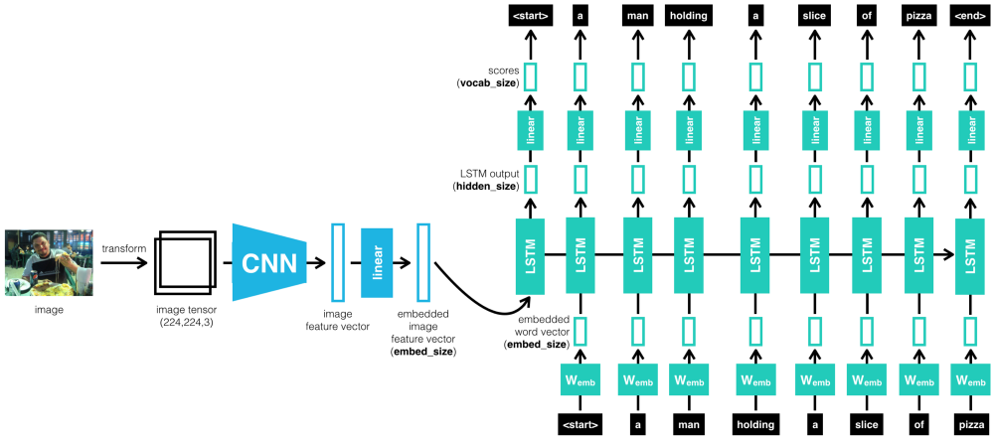
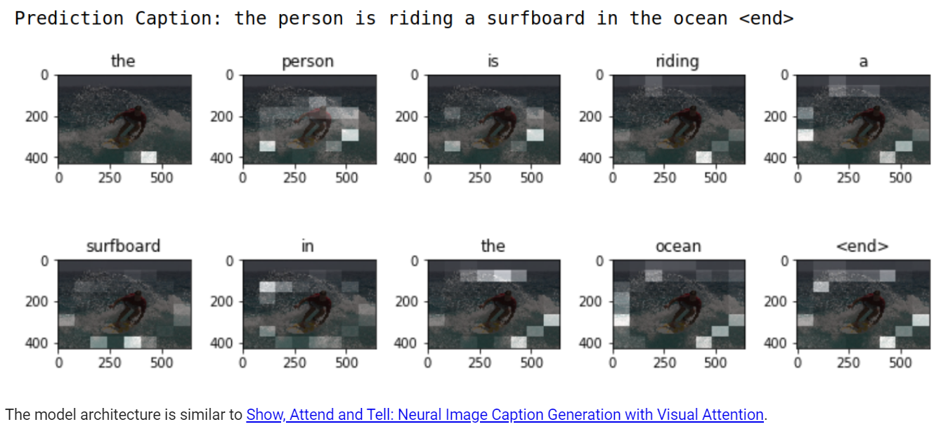
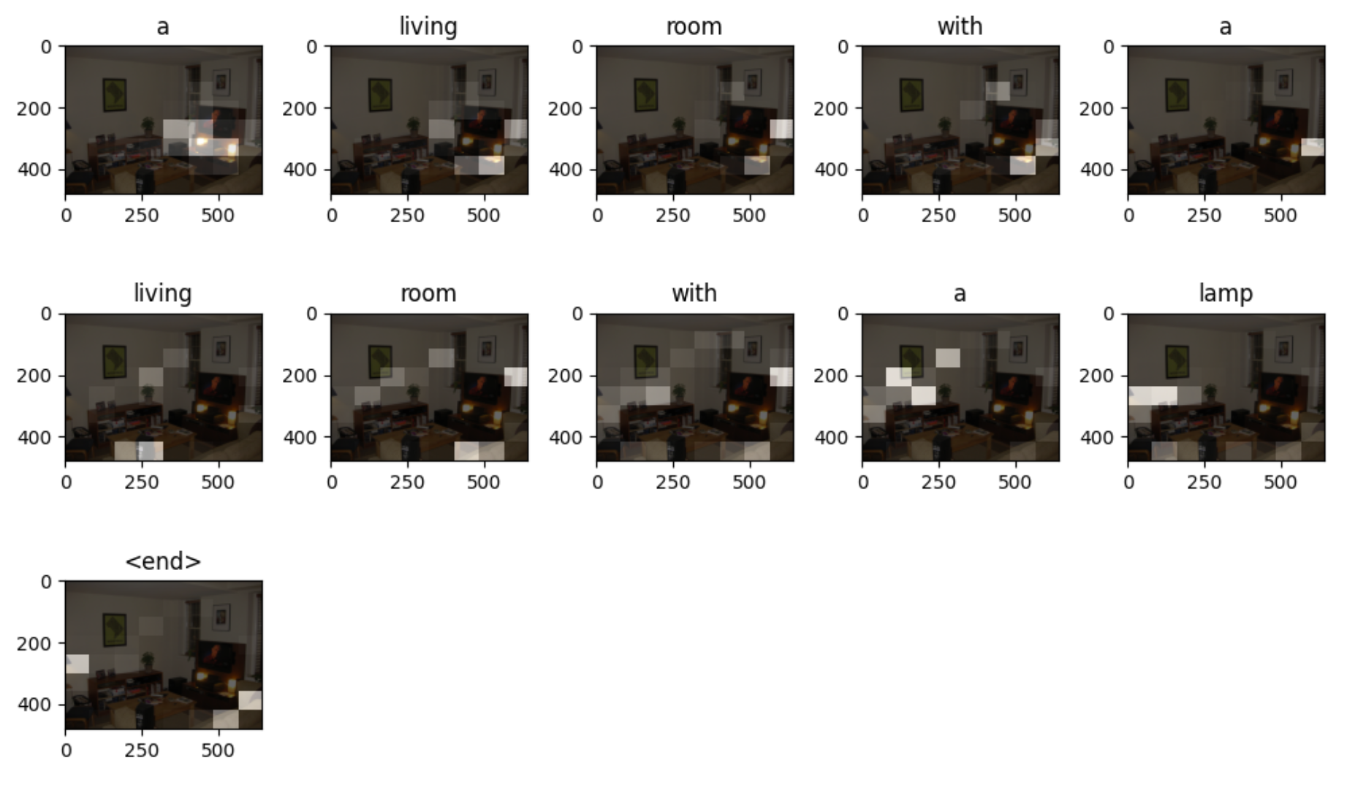
photo

Slide 3
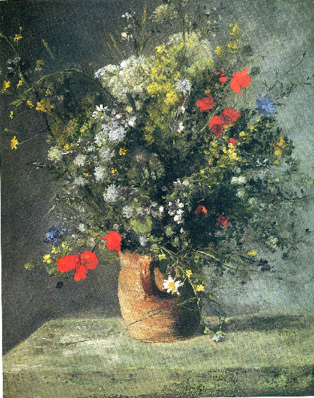
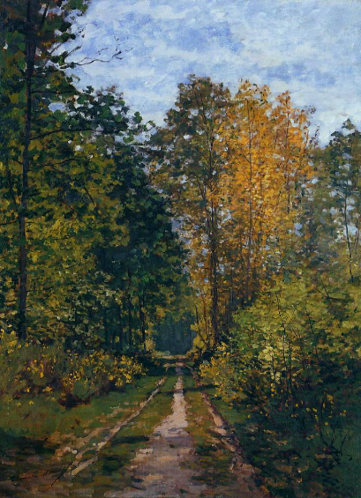
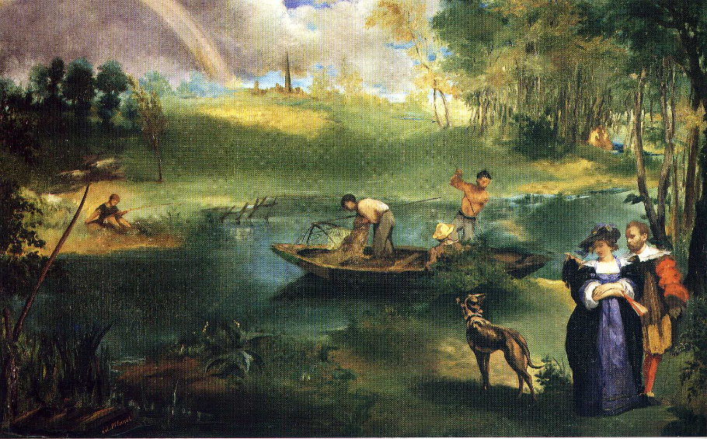
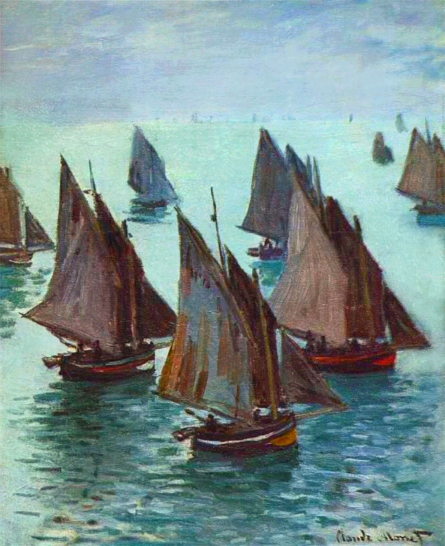
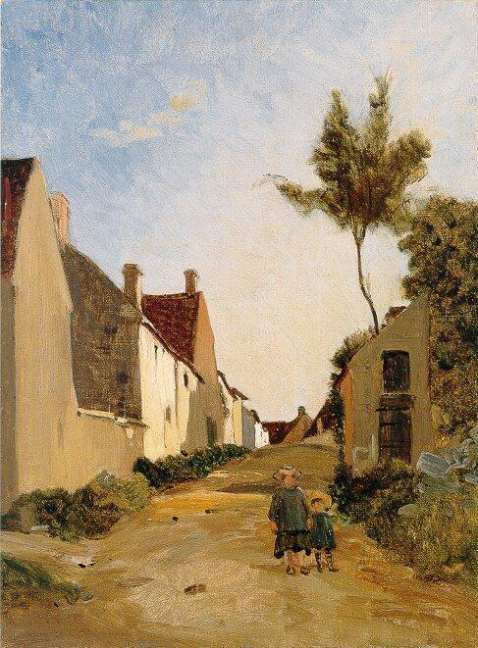
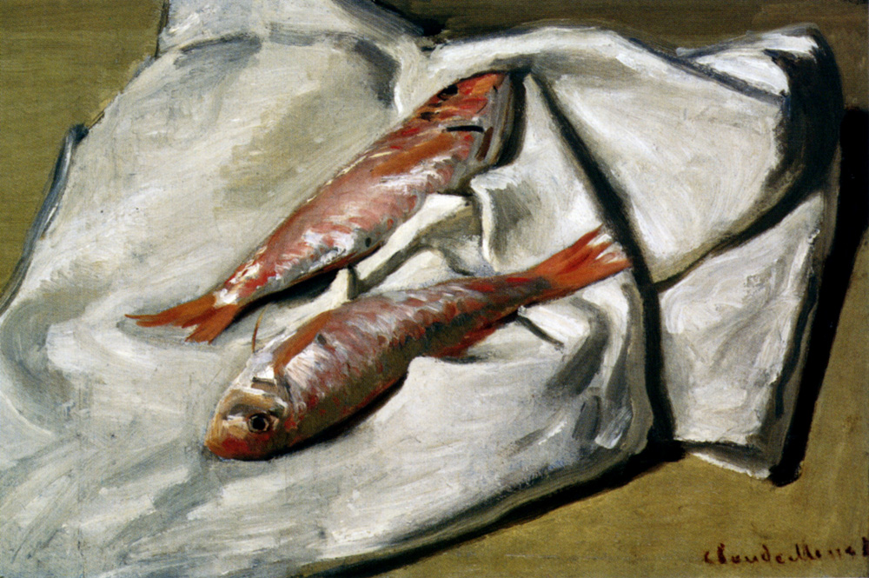
Impressionism - artworks

Slide 4
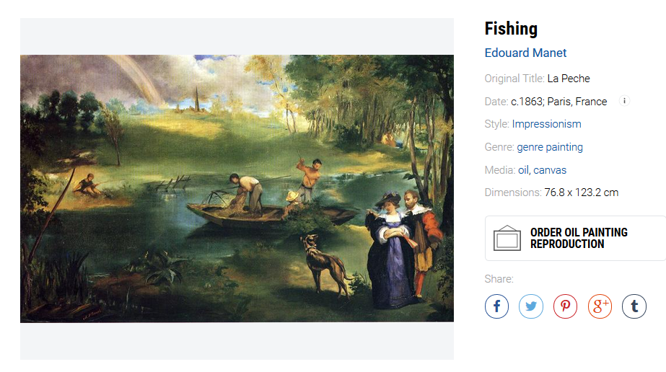
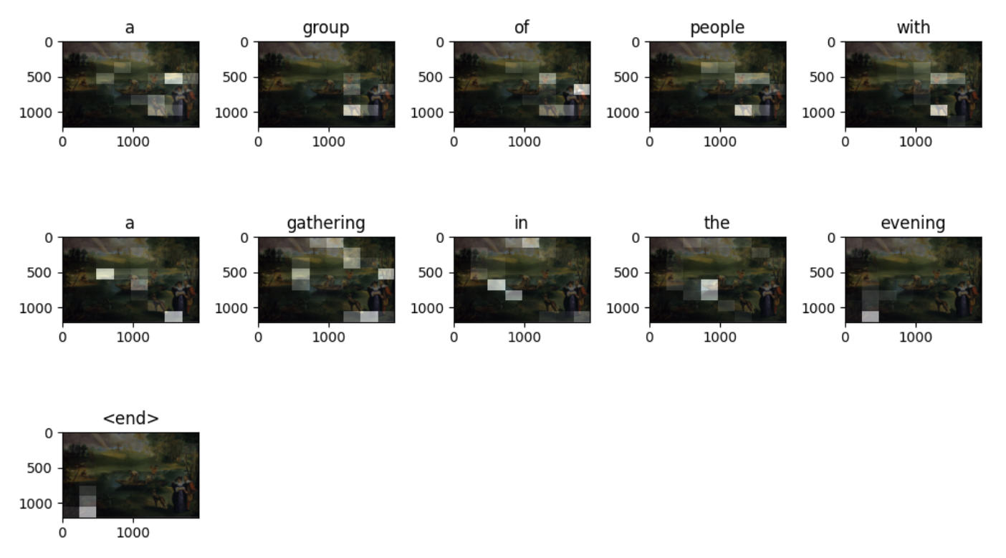
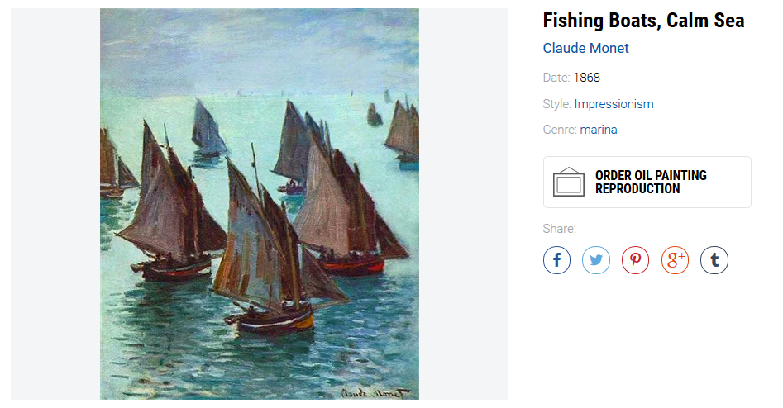
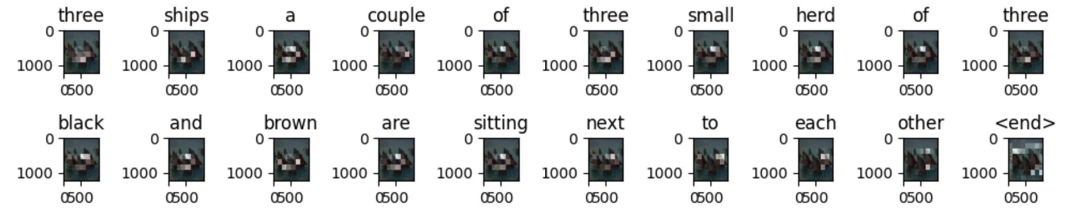
caption
a family of people enjoying a people (5 epoch)
a group of people with a gathering in the evening (10 epoch)
a group of people standing and chairs in the foreground in the foreground (15 epoch)
the view of two boats though it(5 epoch)
three ships a couple of three small herd of three black and brown are sitting next to each other (10 epoch)
group of white boat set together in a body of water (15 epoch)

Slide 5
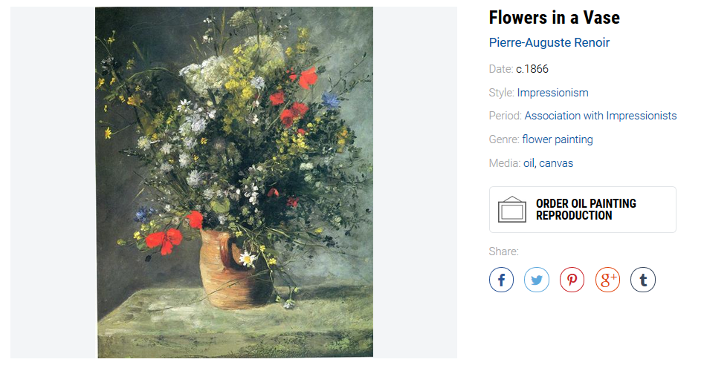
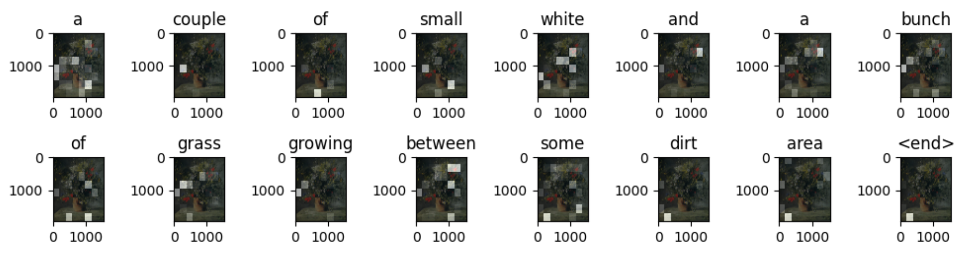
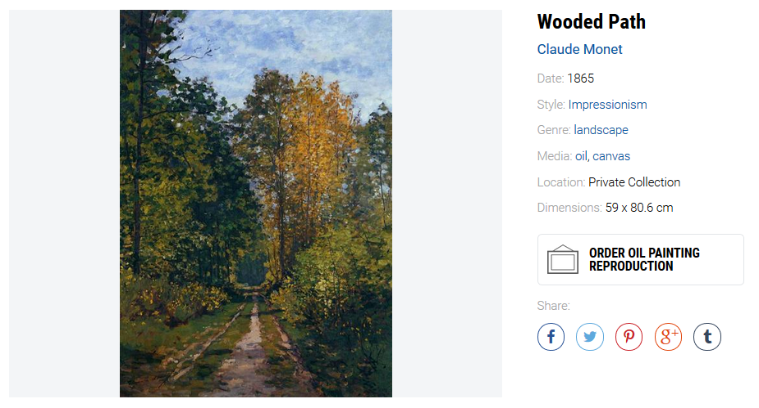
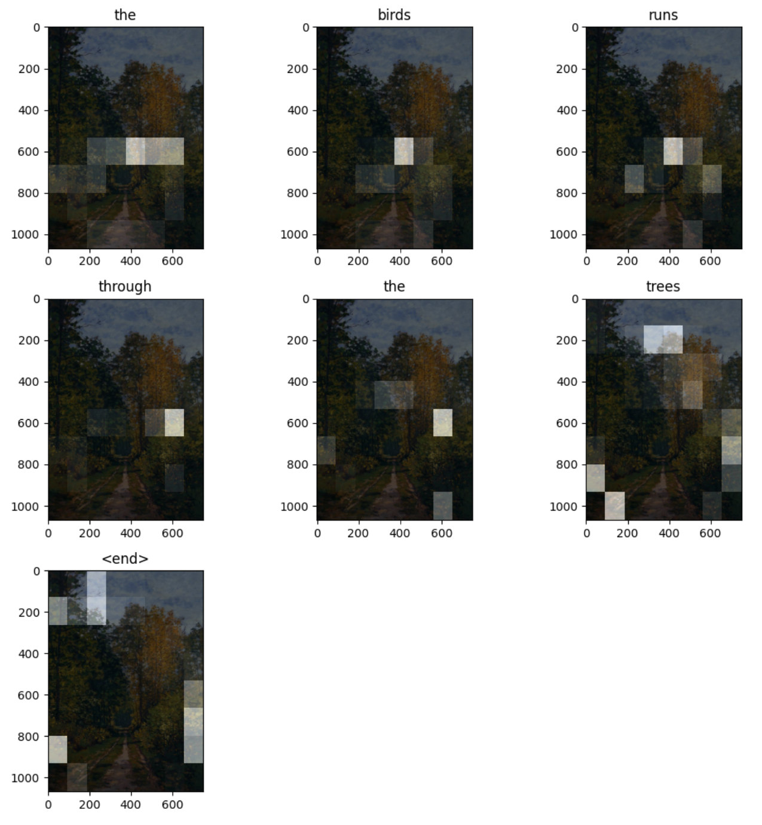
caption
a large window looks for a row of grass on it that is sitting by it (5 epoch)
a couple of small white and a bunch of grass growing between some dirt area (10 epoch)
a bunch of small small small <unk> of <unk> and some grass and grass and grass and grass and grass and grass and fence on the dirt between some dirt (15 epoch)
some people posing for an outside a fence and rocks (5 epoch)
the birds runs through the trees (10 epoch)
the waterway with a park bench in the trees (15 epoch)

Slide 6
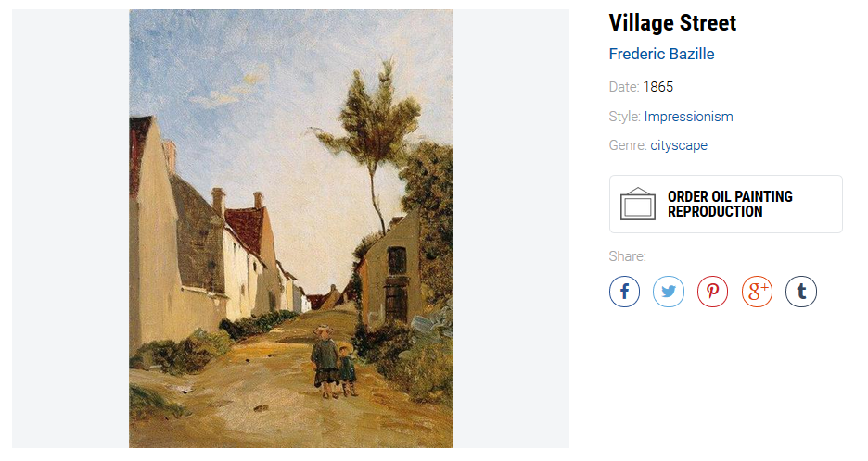
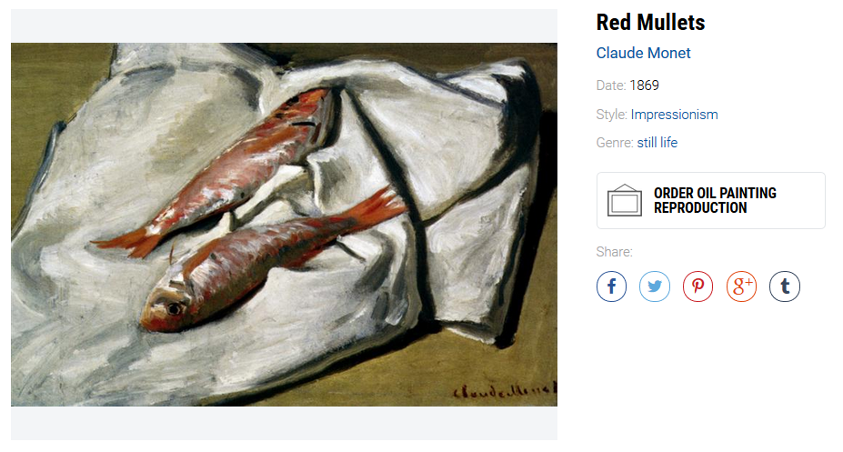
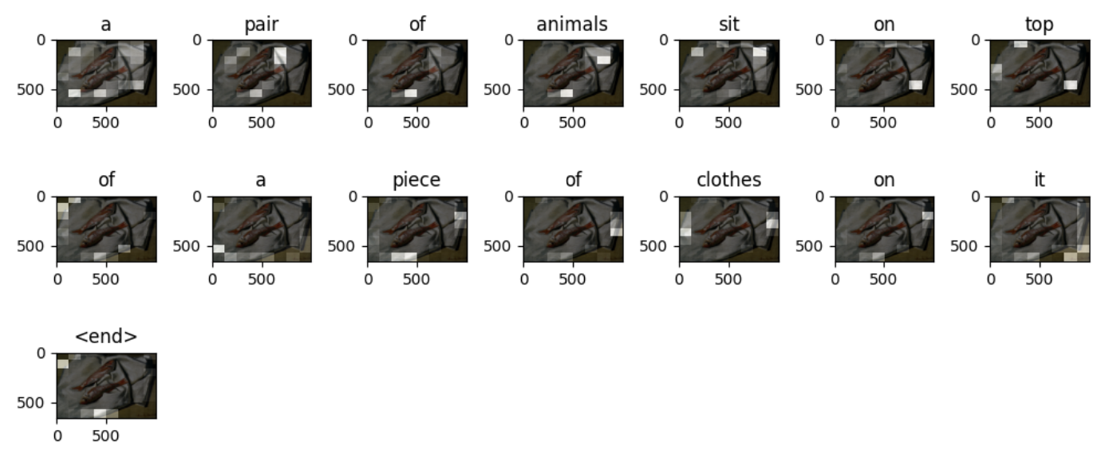
caption
a herd of men are riding upon the building under a lighthouse (5 epoch)
a horse drawn horse drawn carriage next to a tall bushes and a tree while four horses and a couple of back of a tree closely together (10 epoch)
an elephant in front of two giraffes and buildings and buildings and trees (15 epoch)
person eating and a slice of a table (5 epoch)
a pair of animals sit on top of a piece of clothes on it (10 epoch)
a meat and brown ties laying on top of a piece of <unk> on top of a bed (15 epoch)

Slide 7
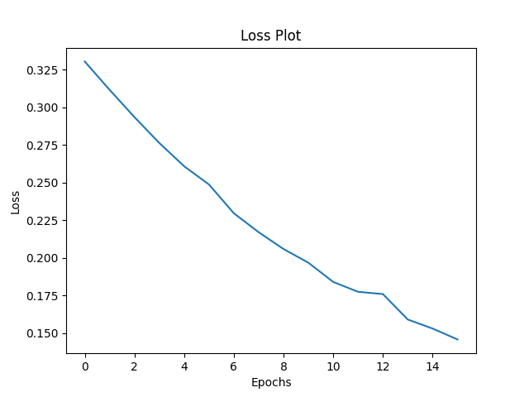
Loss
Epoch 5 Batch 0 Loss 0.3483
Epoch 5 Batch 100 Loss 0.3507
Epoch 5 Batch 200 Loss 0.3286
Epoch 5 Batch 300 Loss 0.3169
Epoch 5 Loss 0.330449
Time taken for 1 epoch 176.69114112854004 sec
Epoch 20 Batch 0 Loss 0.1831
Epoch 20 Batch 100 Loss 0.1402
Epoch 20 Batch 200 Loss 0.1446
Epoch 20 Batch 300 Loss 0.1596
Epoch 20 Loss 0.145856
Time taken for 1 epoch 67.98548817634583 sec

